Slide 1
Welcome to a level chemistry (OCR)
Delivered by Mrs Hargreaves

Slide 2
Course overview
Year 1 (AS) | Year 2 (A2)
Module 1- Development of practical skills | Module 1- Development of practical skills
Module 2- Foundations in chemistry | Module 5- Physical chemistry and transition elements
Module 3- Periodic table and energy | Module 6- Organic chemistry and analysis
Module 4- Core organic chemistry and analysis

Slide 3
Practical endorsement
The practical endorsement (PAGs) assess and develop your practical skills and understanding.
There are a minimum of 12 practical's that cover a range of skills, apparatus and techniques, designed to prepare you further study and careers in science.
This part of the course is teacher assessed and is marks as either completed or not.
In order to complete the module you must have successfully achieved all the skills covered by the PAGs.

Slide 4
Example PAg

Slide 5
Assessment
The exams for Chemisty are synoptic, this means that they assess content from across the modules. This is different to GCSE which is assessed in a more linear way.
Year 1 (AS) | Year 2 (A2
Breadth in chemistry - modules 1-4. 50% | Periodic table, elements and physical chemistry- assesses modules 1, 2, 3 and 5. 37%
Depth in chemistry - modules 1-4. 50% | Synthesis and analytical techniques- assesses modules 1,2, 4 and 6. 37%
 | Unified chemistry- assesses all modules plus practical endorsement skills. 26%
Practical endorsement is assessed separately as complete or incomplete.

Slide 6
Possible Career paths
Analytical Chemist
Chemical Engineer
Chemistry Teacher
Medicine
Forensic Scientist
Geochemist
Hazardous Waste Chemist
Materials Scientist
Pharmacologist
Toxicologist
Water Chemist
And many, many, more!

Slide 7
Taster lesson- Atomic structure, ions and isotopes
Delivered by Mrs Hargreaves

Slide 8
How do we describe atomic structure of atoms and isotopes ?
A
B/C
D
Success Criteria
Explain the terms relative isotopic mass & relative atomic mass
Describe atomic structure
Define the term isotope
AO3
AO2
AO1
Key words: isotopes, protons, neutrons, electrons, atomic number, atomic mass,
Notes:
KS4

Slide 9
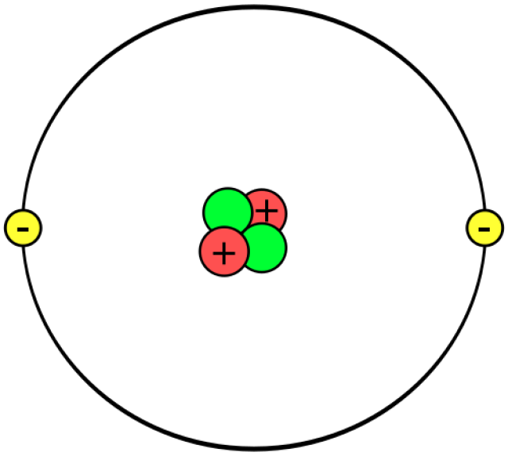
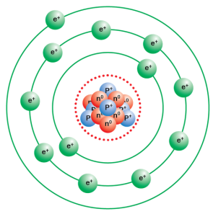
The Atom
At GCSE you will have seen atoms represented like this
⁴₂He
²³₁₁Na
Mass number
(Number of Protons & neutrons)
^{A}_{Z}X
Element symbol
Proton number
(Number of Protons)
Numbers always on the left-hand side

Slide 10
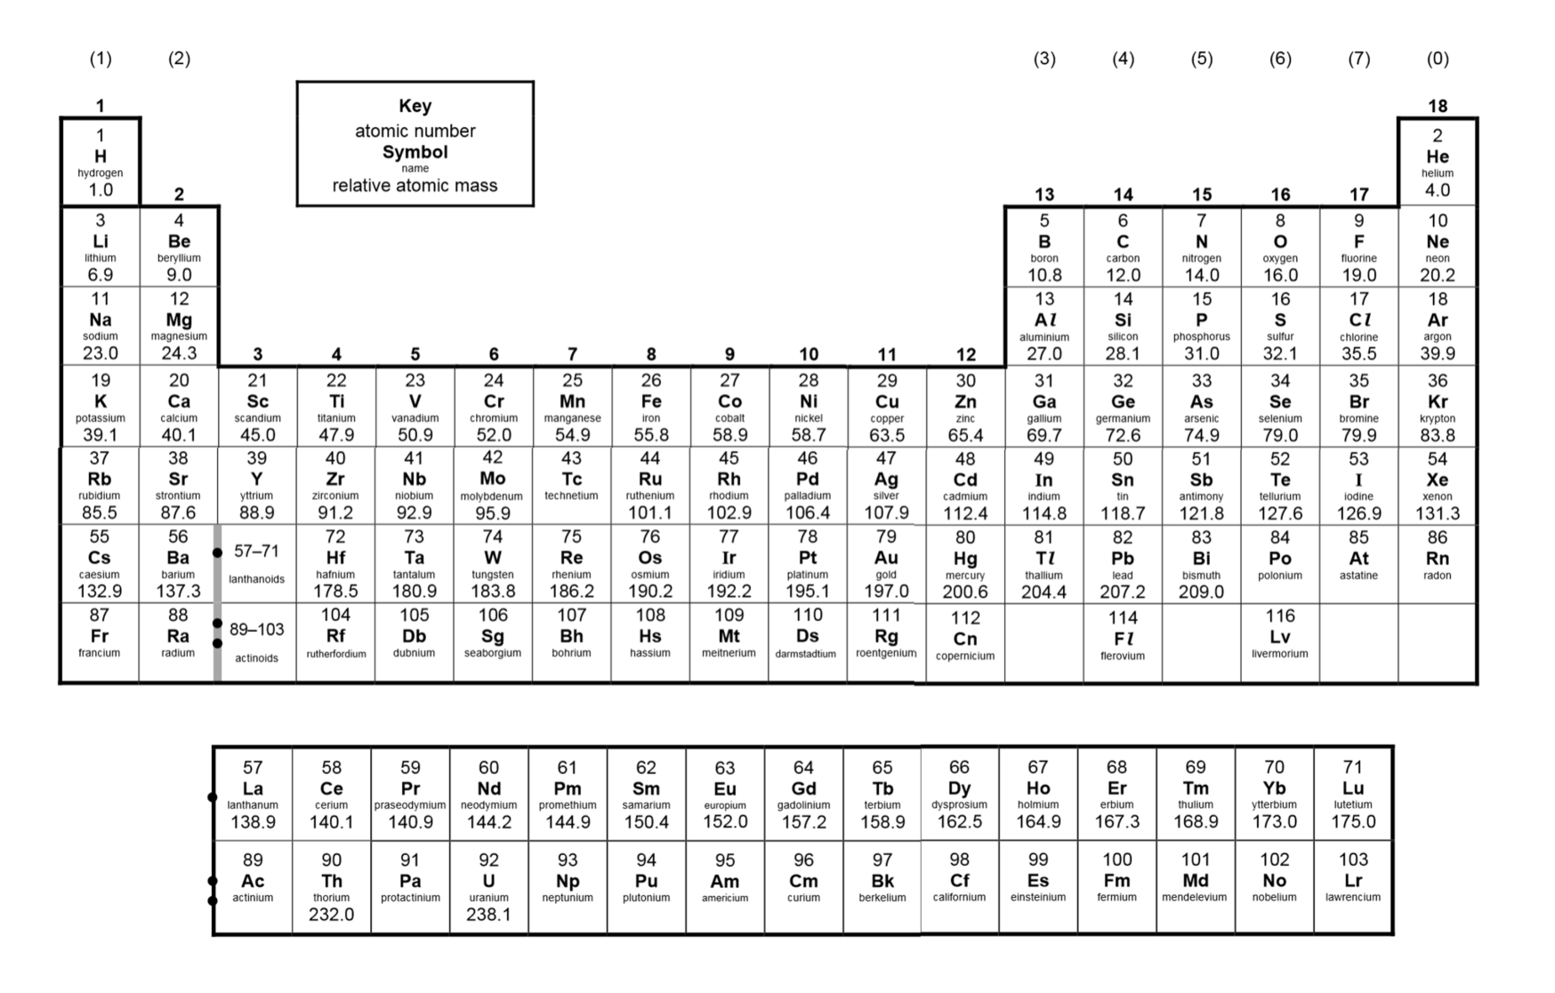

Slide 11
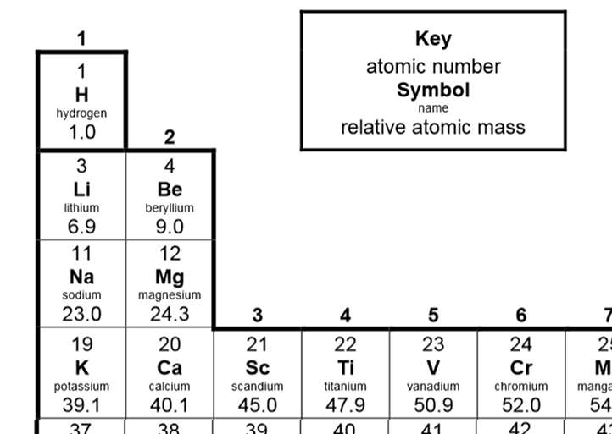
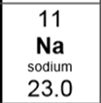
Remember that the table has a key which tells you which number is which
But, not every relative atomic mass is a nice whole number.
The relative atomic mass on the periodic table is an average of the mass numbers of different isotopes
Sodium has an atomic number of 11
It has a relative atomic mass of 23
It has 11 protons and
(23-11 = 12 neutrons)

Slide 12
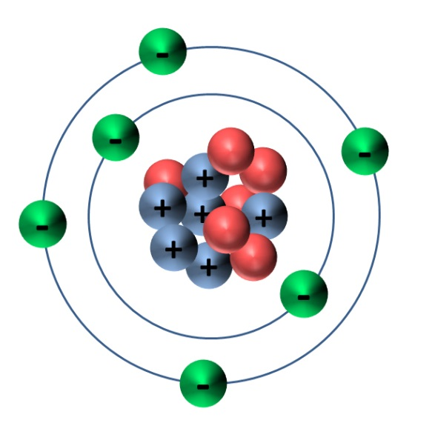
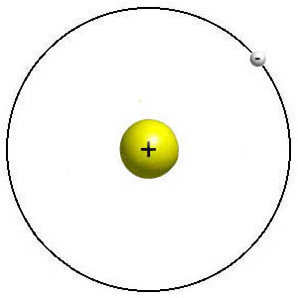
The mass of all atoms are measured relatively to 1/12th the mass of a carbon-12 atom.
(or 1/12th the mass of carbon has a relative mass of 1)
Carbon-12
Hydrogen
Helium
Carbon has a relative mass of 12
Hydrogen has a relative mass of 1
This means 12 hydrogen atoms have the same mass as 1 carbon atom
Helium has a relative mass of 4
This means 3 helium atoms have the same mass as 1 carbon atom

Slide 13
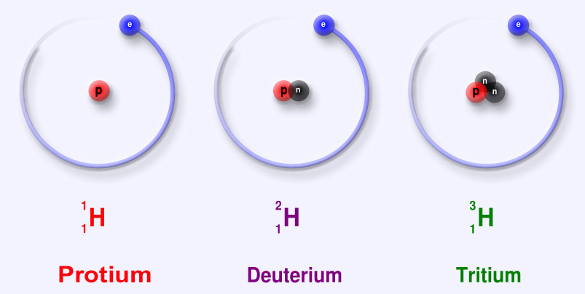
Isotopes of an element have the same atomic number, but a different mass number due to different numbers of neutrons.
Hydrogen has 3 different isotopes each one has a different relative isotopic mass
Relative isotopic mass is the mass of the isotope compare to 1/12th the mass of Carbon-12

Slide 14
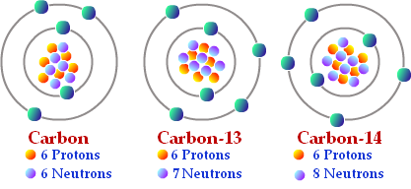
Atom | Name | Atomic number | Mass number | No. of protons | No. of neutrons | No. of electrons
¹² C ⁶
¹³C ⁶
¹⁴ C ⁶
Carbon-12
6
12
6
6
6
Carbon-13
6
13
6
7
6
Carbon-14
6
14
6
8
6

Slide 15
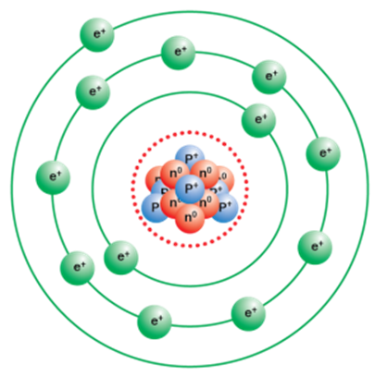
From GCSE you will be familiar with the atom looking like this
But the model of the atom we use has developed over time.

Slide 16
Quick quiz!
What have you remembered?

Slide 17
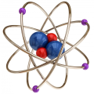
Question 1
22 June 2020
Which of these is the definition of isotope?
A |  | Atoms of the same element with the same number of neutrons, but different numbers of electrons
B |  | Atoms of the same element with the same number of electrons, but different numbers of protons
C |  | Atoms of the same element with the same number of protons, but different numbers of neutrons
D |  | Atoms of the same element with the same number of neutrons, but different numbers of protons

Slide 18
Question 2
22 June 2020
How many protons does this isotope of potassium have?
⁴⁰₁₉K
A |  | 40
B |  | 21
C |  | 59
D |  | 19

Slide 19
Question 3
22 June 2020
How many neutrons does this isotope of calcium have?
⁴⁸₂₀Ca
A |  | 48
B |  | 20
C |  | 28
D |  | 68

Slide 20
Question 4
22 June 2020
How many electrons does this isotope of sulphur have?
³⁴₁₆Ca
A |  | 16
B |  | 34
C |  | 50
D |  | 18

Slide 21
Question 5
22 June 2020
What is relative atomic mass?
A |  | The mass of one atom of an element to one twelfth of the mass of an atom of carbon-12.
B |  | The ratio of the average mean mass of one atom of an element to one twelfth of the mass of an atom of carbon-12.
C |  | The ratio of the average mean mass of one atom of an element to carbon-12.
D |  | The ratio of the average mean mass of one atom of an element to one twelfth of the mass of an atom of carbon-13.

Slide 22
Answers
C
D
C
A
B

Slide 23
Atomic structure and isotopes
22 June 2020
How did you do?
5 out of 5 = A
4 out of 5 = B
3 out of 5 = C
2 out of 5 = D
1 out of 5 = E
0 out of 5 = U

Slide 24
Thank you!
Thank you for watching, I hope you found it useful.
If you have any questions I will be at the Q&A or you can email me at;
shargreaves.72@kingswoodsecondaryacademy.org
Specification links
AS- https://www.ocr.org.uk/Images/171750-specification-accredited-as-level-gce-chemistry-a-h032.pdf
A2- https://www.ocr.org.uk/Images/171720-specification-accredited-a-level-gce-chemistry-a-h432.pdf

